Slide 1
JHUMRI TELAIYA COMMERCE COLLEGE
Welcome To NAAC Peer Team

Slide 2
Department of Commerce
Mr. Amit Kumar
Asstt. Prof.
Deptt. of Commerce

Slide 3
About the Department
The Department of Commerce was established in the year 1984. The college started with B.A. and B.Com courses. Language commerce is compulsory for both these courses. Keeping in pace with new trends in education and job opportunities, plans are there to introduce new subjects and combination of Journalism, Combination of banking, tax was established in 1984. Ranchi University and Now (Vinoba Bhave University) has introduced choice based credit system from 2015-16.
The Department of Commerce aims for the Holistic development of the students. The remarkable achievement of our department is in terms of successful graduates who are now serving the society in diverse capacities in various central, state and private organization.

Slide 4
PERSONAL PROFILE
NAME: Mr. Amit Kumar
DESIGNATION: M.Com
EXPERIENCE: 2years
Paper specialization: Accountant

Slide 5
Faculty
SL. No. | Name of the Faculty | Designation | Qualification | Experience
1 | Mr. Amit Kumar | Asstt. Professor | MA | 2

Slide 6
Students Strength
Sl. No | Year | SC | ST | OBC | GEN | Total
01 | 2018-19 | 03 | 0 | 47 | 08 | 58
02 | 2019-20 | 11 | 0 | 48 | 11 | 70
03 | 2020-21 | 02 | 0 | 25 | 10 | 37
04 | 2021-22 | 01 | 0 | 24 | 09 | 34
05 | 2022-23 | 02 | 0 | 24 | 08 | 34

Slide 7
Students Result
Sl. No | Year | Appear | Passed | Remarks
01 | 2018-19 | 3 | 3
02 | 2019-20 | 13 | 7
03 | 2020-21 | 4 | 2
04 | 2021-22 | 27 | 18
05 | 2022-23 | 45 | 36

Slide 8
Highest Score
Sl. No | Year | Name of the student | CGPA | Remarks
01 | 2018-19 | Soni Kumari | 6.53 | College Topper
02 | 2019-20 | Sneha Sinha | 7.43 | College Topper
03 | 2020-21 | Ratnesh Kr. Saw | 7.46 | College Topper
04 | 2021-22 | Anand Kumar | 7.16 | College Topper
05 | 2022-23 | Jigyasa Singh | 7.51 | College Topper

Slide 9
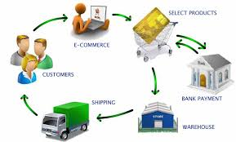
Content
Historical background of commerce
Objectives of business
Classification of business activities.

Slide 10
Barter system:
A barter system is an old method of exchange.
This system has been used for centuries and long before money was invented.
People exchanged services and goods for other services and goods in return.
Without using any medium of exchange.
Constraints of barter system:
Lack of double coincidence of wants.
Non existence of common measure of value.
Lack of direct contract between buyer and seller.
Lack of surplus stock.

Slide 11
Hindrance meaning: delay, obstruction.
Hindrance of commerce:
Hindrance of person (wholesalers to consumers)
Hindrance of place (Transport types)
Hindrance of time (willingness to buy)
Hindrance of risk of loss (Calamities)
Hindrance of knowledge (Communication + Innovation)
Hindrance of finance (Banks or financial institution)
Hindrance of exchange (Medium of exchange)

Slide 12
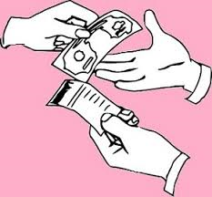
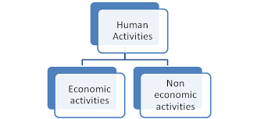
2. Objectives of business

Slide 13
Introduction:
Human activities:
Human activity is an activity performed by a human being to meet his/her needs and wants or may be for personal satisfaction.
Human activities can be categorized into :
Economic
Non-economic activities.

Slide 14
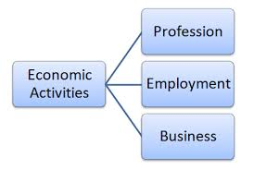
Economic activity:
Activities undertaken with the object of earning money are called economic activities.
Service are rendered by profit motive.

Slide 15
Non economic activity:
Activities undertaken to satisfy social and psychological needs are called non-economic activities
Example:
Cooking food for family
Celebrating festival

Slide 16
Types of economic activities:
Occupations may be classified into three categories based on the following:-
A. Employment
B. Profession
C. Business

Slide 17
Employment:
It refers to the occupation in which people work for others and get remuneration in the form of wages or salaries.
The one who is employed by others are called employees .
The one who employs others is called employer.

Slide 18
Profession:
Professions are those occupations which involve rendering of personal services of a special and expert nature.
A profession is something which is more than a job.
Those engaged in a profession are called professionals and they earn income by charging professional fee.

Slide 19
Business:
Business refers to any human activity undertaken on a regular basis with the object to earn profit through production, distribution, purchase and sale of goods and services.

Slide 20
Classification of business activities:
Activities based on size.
Activities based on ownership.
Activities based on function.

Slide 21
1. Activities based on size:
On the basis of size, business activities may be broadly grouped into two categories.
Small scale:
Small scale units require less capital.
They employ small number of workers and produce the goods on small scale.
Large scale:
Large scale units require huge capital.
They employ large number of workers and produce the goods on large scale.

Slide 22
Activities based on ownership:
Private enterprises:
An enterprise is said to be a private enterprise where it is owned, managed and controlled by persons other than Government.
2. Public enterprises:
An enterprise is said to be a public enterprise where it is owned, managed and controlled by Government or any of its agencies or both.

Slide 23
3. Joint enterprises:
An enterprise is said to be a joint enterprise where it is owned, managed and controlled by Government and private entrepreneurs.
Example - Maruti Suzuki

Slide 24
Activities based on function:
Industry:
Industry includes all those business activities which are connected with raising, producing or processing of consumer goods.
Commerce:
It establishes a link between the producers and consumers of goods and maintains a smooth and uninterrupted flow of goods from producers to consumers.

Slide 25
Characteristics of business:
Profit motive
Element of risk
Production of goods
Dealing in goods and service.
Long lasting impact
Creation of utilities

Slide 26
Objectives of business:
Economic objective
Social objective
Organizational objective
National objective
Human objective

Slide 27
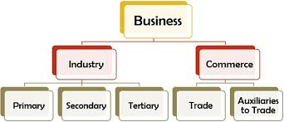
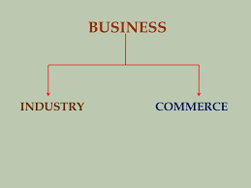
3. Classification of business activities

Slide 28
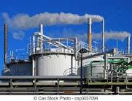
Industry
Meaning:
Industry is used for activities in which mechanical appliances and technical skills are involved.
The manufacturers produces the goods for the consumers at one point of location.
They distribute the goods to final consumer through intermediaries like wholesaler, retailers, distributors , customer.

Slide 29
Kinds of industries:

Slide 30
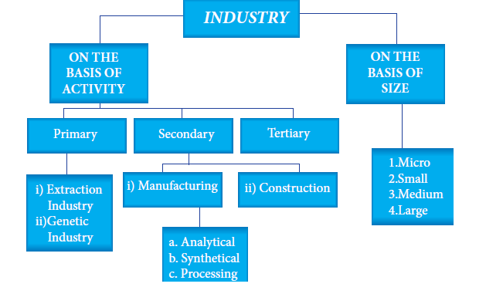

Slide 31
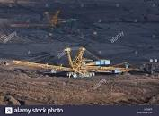
On the basis of activities:
Primary activity -- (nature oriented history ) Agriculture, farming, fishing etc…
Extractive industry:
Genetic industry:
Transformed to many useful things
Ex: mining, oil drilling, farming.
Breeding plants and animals
Ex: Diary, piggery, nursery

Slide 32
Secondary industries:
Produce goods for final consumption.
Ex: Manufacturing steel.
A. Manufacturing industry:
Analytical industry
Synthetic industry
Processing industry
Assembling industry
B. Construction industry

Slide 33
Analytical Industry which analyses and separates different elements from the same materials, as in the case of oil refinery.
b. Synthetic Industry which combines various ingredients into a new product, as in the case of cement.
c. Processing Industry which involves successive stages for manufacturing finished products, as in the case of sugar and paper.
d. Assembling Industry which assembles different component parts to make a new product, as in the case of television, car, computer, etc.

Slide 34
Territory industry:
Territory industry does not produce an goods.
Provides service and sells at profit.
Help in industry, trade, transportation , commerce etc…

Slide 35
Classification of territory industry:
Personalised service: Individuals and private institutions selling their services to others. E.g. plumber, servant maid, etc.
ii. Public Service: Government hospitals, schools, police, Government offices, etc. provide services to the people on behalf of the Government without profit motive.
iii. Distributive Service: Transportation, warehousing, logistics, salesmanship, etc. come under this type of service.
iv. Financial Service: Banking, factoring, accounting, and insurance, etc. are grouped under this type of service.
v. Quaternary Service: Professional or specialised skills and high technology are used to provide this type of service.

Slide 36
On the basis of size:
Micro industries
Medium industries
Small industries
Large industries

Slide 37
Auxiliaries to trade and commerce:
Commerce refers to all those activities which are necessary for bringing goods from the place of production to the place of their consumption.
1. Trade is used to denote buying and selling. It helps in making the goods produced available to ultimate consumers or users.
2. Transportation (one place to another)
3. Warehouse (storage of goods)
4. Financial institution (Banking)
5. Insurance (Loss or damage)

Slide 38
Thank you

