Slide 1
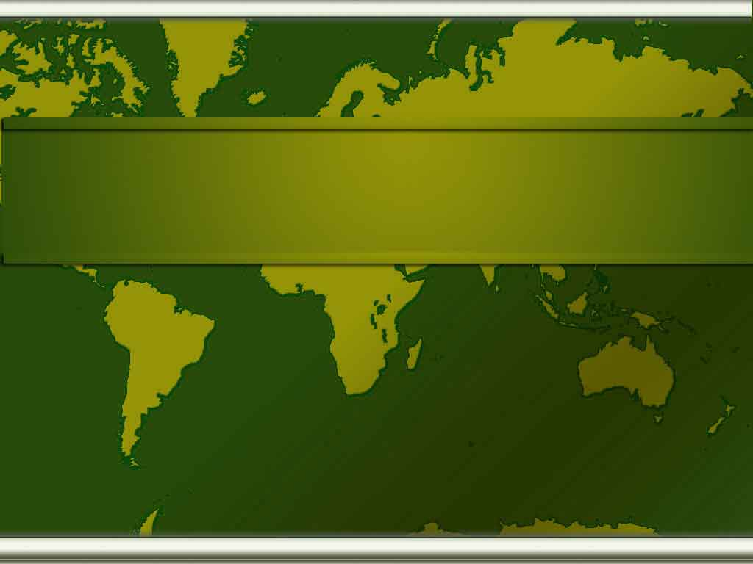
Department of Geography
BY SUNIL KUMAR
Asstt. Prof.
Department of Geography

Slide 2
JHUMRI TELAIYA COMMERCE COLLEGE

Slide 3
Year of Establishment
Department of Geography was established in 1984.
Ranchi University and Now (Vinoba Bhave University) has introduced
choice based credit system from 2015-16.

Slide 4
Faculty
SL. No. | Name of the Faculty | Designation | Qualification | Experience
1 | Mr. Sunil Kumar | Asstt. Professor | MA, NET | 5

Slide 5
Students Strength
Sl. No | Year | SC | ST | OBC | GEN | Total
01 | 2018-19
02 | 2019-20
03 | 2020-21
04 | 2021-22
05 | 2022-23

Slide 6
I. Meaning of Geography
Greek word, geographia, "earth description“
A science that deals with the description, distribution, and interaction of the diverse physical, biological, and cultural features of the earth’s surface.
A delineation, or systematic arrangement of constituent elements.

Slide 7
II. The concept of geography
Geography identifies the concepts of place, space environment, interconnection, sustainability, scale and change as integral to the development of geographical understanding.

Slide 8
History of Geographic Study
Evolution
Geography was first systematically studied by the ancient Greeks, who also developed a philosophy of geography; Thales of Miletus, Herodotus, Eratothenes, Aristotle, Strabo, and Ptolemy made major contributions to geography. The Roman contribution to geography was in the exploration and mapping of previously unknown lands. Greek geographic learning was maintained and enhanced by the Arabs during the middle Ages. Arab geographers, among whom Idrisi, Ibn Battutah, and Ibn Khaldun are prominent, traveled extensively for the purpose of increasing their knowledge of the world. The journeys of Marco Polo in the latter part of the Middle Ages began the revival of geographic interest outside the Muslim world.

Slide 9
With the Renaissance in Europe came the desire to explore unknown parts of the world that led to the voyages of exploration and to the great discoveries. However, it was mercantile interest rather than a genuine search for knowledge that spurred these endeavors. The 16th and 17th century. Reintroduced sound theoretical geography in the form of textbooks (the Geographia generalis of Bernhardus Varenus) and maps (Gerardus Mecator's world map). In the 18th cent. geography began to achieve recognition as a discipline and was taught for the first time at the university level.

Slide 10
Modern Geography
The modern period of geography began toward the end of the 18th cent. with the works of Alexander von Humboldt and Karl Ritter. Thenceforth two principal methods of approach to geography can be distinguished: the systematic, following Humboldt, and the regional, following Ritter. Of the national schools of geography that developed, the German and the French schools were the most influential.

Slide 11
The German school, which dealt mainly with physical geography, developed a scientific and analytical style of writing. The French school became known for its descriptive regional monographs presented in a lucid and flowing manner; human and historical geography were its forte. Although emphasis has shifted several times between the approaches and viewpoints, their interdependence is recognized by all geographers.

Slide 12
Nature of Geography
Geography is concerned with place. Understanding the nature and causes of areal differentiation on the global surface has been the geographer’s task since people first noticed differences between places.
First, geography is strongly influenced by the norms of the social sciences. The complexity and changing nature of human society seldom permit the type of precision expected in the physical sciences. Instead, the social sciences offer a variety of perspectives and methods of study by which to examine the consequences of human behavior on the global surface

Slide 13
Second, physical geographers, no less than human geographers, contribute to an understanding of place; for the concept of site -- the physical characteristics of a place -- is integral to understanding areal differentiation on the global surface.
The view of geography presented here is that of a core sharply focused on the concept of place; one in which both physical and human elements play an important part in yielding knowledge of the earth in a manner that is integrative of people and the land.

Slide 14
Elements of Geography
1. The World in Spatial Terms
a. How to use maps and other geographic representations, tools, and technologies to acquire, process, and report information from a spatial perspective
b. How to use mental maps to organize information about people, places, and environments in a spatial context
c. How to analyze the spatial organization of people, places, and environments on earth's surface
2. Places and Regions
a. The physical and human characteristics of places
b. That people create regions to interpret earth's complexity
c. How culture and experience influence people's perceptions of places and regions

Slide 15
3. Physical Systems
a. The physical processes that shape the patterns of earth's surface
b. The characteristics and spatial distribution of ecosystems on earth's surface
4. Human Systems
a. The characteristics, distribution, and migration of human populations on earth's surface
b. The characteristics, distribution, and complexity of earth's cultural mosaics
c. The patterns and networks of economic interdependence on earth's surface
d. The processes, patterns, and functions of human settlement
e. How the forces of cooperation and conflict among people influence the division and control of earth's surface

Slide 16
5. Environment and Society
a. How human actions modify the physical environment
b. How physical systems affect human systems
c. The changes that occur in the meaning, use, distribution, and importance of resources
6. The Uses of Geography
a. How to apply geography to interpret the past
b. How to apply geography to interpret the present and plan for the future

Slide 17
IMPORTANCE of geography
Geography provokes and answers questions about the natural and human worlds, using different scales of enquiry to view them from different perspectives.
It develops knowledge of places and environments throughout the world, an understanding of maps, and a range of investigative and problem solving skills both inside and outside the classroom. As such, it prepares pupils for adult life and employment.

Slide 18
Geography is a focus within the curriculum for understanding and resolving issues about environment and sustainable development.
It also an important link between the natural and social sciences. As pupils study geography, they encounter different societies and cultures.
This helps them realize how nations rely on each other.
It can inspire them to think about their own place in the world, values and their rights and responsibilities to other people and the environment.

Slide 19
The relationship of geography to other social science disciplines
This revived interest in places is a feature of the third contemporary strand, with geographers participating in the growing field of cultural studies that encompasses scholars from the humanities and social sciences in new ways of studying human action in context. Such work ranges over many aspects of behavior, including the micro-scale of the individual body, seeking to understand the meanings that underpin actions – many of which are never recorded during the processes of everyday life –and how communities and groups identify with places and spaces.

Slide 20
The relationships between people and nature are also being reconsidered, breaking down the perceived artificial boundaries between these long-considered opposites. New approaches for interrogating actions are being explored: geography quite literally studies where events ‘take place’ and the impact of those events is reflected in the places’ character. Indeed, such is the geographical contribution to cultural studies that some identify a ‘spatial turn’ within the humanities.

Slide 21
Physical geography
The natural environment is the primary concern of physical geographers, although many physical geographers also look at how humans have altered natural systems. Physical geographers study Earth’s seasons, climate, atmosphere, soil, streams, landforms, and oceans. Some disciplines within physical geography include geomorphology, glaciology, pedology, hydrology, climatology, biogeography, and oceanography.

Slide 22
Geomorphology is the study of landforms and the processes that shape them. Geomorphologists investigate the nature and impact of wind, ice, rivers, erosion, earthquakes, volcanoes, living things, and other forces that shape and change the surface of the Earth. Glaciologists focus on the Earth’s ice fields and their impact on the planet’s climate. Glaciologists document the properties and distribution of glaciers and icebergs. Data collected by glaciologists has demonstrated the retreat of Arctic and Antarctic ice in the past century.

Slide 23
Pedologists study soil and how it is created, changed, and classified. Soil studies are used by a variety of professions, from farmers analyzing field fertility to engineers investigating the suitability of different areas for building heavy structures. Hydrology is the study of Earth’s water: its properties, distribution, and effects. Hydrologists are especially concerned with the movement of water as it cycles from the ocean to the atmosphere, then back to Earth’s surface. Hydrologists study the water cycle through rainfall into streams, lakes, the soil, and underground aquifers. Hydrologists provide insights that are critical to building or removing dams, designing irrigation systems, monitoring water quality, tracking drought conditions, and predicting flood risk.

Slide 24
Climatologists study Earth’s climate system and its impact on Earth’s surface. For example, climatologists make predictions about El Nino, a cyclical weather phenomenon of warm surface temperatures in the Pacific Ocean. They analyze the dramatic worldwide climate changes caused by El Nino, such as flooding in Peru, drought in Australia, and, in the United States, the oddities of heavy Texas rains or an unseasonably warm Minnesota winter. Biogeography's study the impact of the environment on the distribution of plants and animals. For example, a biogeography might document all the places in the world inhabited by a certain spider species, and what those places have in common.

Slide 25
Oceanography, a related discipline of physical geography, focuses on the creatures and environments of the world’s oceans. Observation of ocean tides and currents constituted some of the first oceanographic investigations. For example, 18th-century mariners figured out the geography of the Gulf Stream, a massive current flowing like a river through the Atlantic Ocean. The discovery and tracking of the Gulf Stream helped communications and travel between Europe and the Americas. Today, oceanographers conduct research on the impacts of water pollution, track tsunamis, design offshore oil rigs, investigate underwater eruptions of lava, and study all types of marine organisms from toxic algae to friendly dolphins.

Slide 26
Human geography
Human geography is concerned with the distribution and networks of people and cultures on Earth’s surface. A human geographer might investigate the local, regional, and global impact of rising economic powers China and India, which represent 37 percent of the world’s people. They also might look at how consumers in China and India adjust to new technology and markets, and how markets respond to such a huge consumer base. Human geographers also study how people use and alter their environments. When, for example, people allow their animals to overgraze a region, the soil erodes and grassland is transformed into desert. The impact of overgrazing on the landscape as well as agricultural production is an area of study for human geographers.

Slide 27
Finally, human geographers study how political, social, and economic systems are organized across geographical space. These include governments, religious organizations, and trade partnerships. The boundaries of these groups constantly change. The main divisions within human geography reflect a concern with different types of human activities or ways of living. Some examples of human geography include urban geography, economic geography, cultural geography, political geography, social geography, and population geography. Human geographers who study geographic patterns and processes in past times are part of the sub discipline of historical geography. Those who study how people understand maps and geographic space belong to a sub discipline known as behavioral geography.

Slide 28
Many human geographers interested in the relationship between humans and the environment work in the sub disciplines of cultural geography and political geography.
Cultural geographers study how the natural environment influences the development of human culture, such as how the climate affects the agricultural practices of a region. Political geographers study the impact of political circumstances on interactions between people and their environment, as well as environmental conflicts, such as disputes over water rights. Some human geographers focus on the connection between human health and geography. For example, health geographers create maps that track the location and spread of specific diseases. They analyze the geographic disparities of health-care access. They are very interested in the impact of the environment on human health, especially the effects of environmental hazards such as radiation, lead poisoning, or water pollution.

Slide 30
THE GLOBE
A globe is a three-dimensional, spherical, scale model of Earth (terrestrial globe or geographical globe) or other celestial body such as a planet or moon. While models can be made of objects with arbitrary or irregular shapes, the term globe is used only for models of objects that are approximately spherical.

Slide 32
Latitude Lines Imaginary lines running horizontally around the globe. Also called parallels, latitude lines are equidistant from each other. Each degree of latitude is about 69 miles (110 km) apart. Zero degrees (0°) latitude is the equator, the widest circumference of the globe. Latitude is measured from 0° to 90° north and 0° to 90° south—90° north is the North Pole and 90° south is the South Pole.
Longitude Lines Imaginary lines, also called meridians, running vertically around the globe. Unlike latitude lines, longitude lines are not parallel. Meridians meet at the poles and are widest apart at the equator. Zero degrees longitude (0°) is called the prime meridian. The degrees of longitude run 180° east and 180° west from the prime meridian.

Slide 33
Equator Zero degrees latitude. The Sun is directly overhead the equator at noon on the two equinoxes (March and Sept. 20 or 21). The equator divides the globe into the Northern and Southern hemispheres. The equator appears halfway between the North and South poles, at the widest circumference of the globe. It is 24,901.55 miles (40,075.16 km) long
Hemisphere a half of the earth, usually as divided into northern and southern halves by the equator, or into western and eastern halves by an imaginary line passing through the poles.
Grid latitude and longitude lines form an imaginary grid over the Earth’s surface.

Slide 34
Prime Meridian Zero degrees longitude (0°). The prime meridian runs through the Royal Greenwich Observatory in Greenwich, England (the location was established in 1884 by international agreement). The prime meridian divides the globe into the Western and Eastern hemispheres. The Earth's time zones are measured from the prime meridian. The time at 0° is called Universal Time (UT) or Greenwich Mean Time (GMT). With the Greenwich meridian as the starting point, each 15° east and west marks a new time zone. The 24 time zones extend east and west around the globe for 180° to the International Date Line.

Slide 35
International Date Line Located at 180° longitude (180° E and 180° W are the same meridian). Regions to the east of the International Date Line are counted as being one calendar day earlier than the regions to the west. Although the International Date Line generally follows the 180° meridian (most of which lies in the Pacific Ocean), it does diverge in places. Since 180° runs through several countries, it would divide those countries not simply into two different time zones, but into two different calendar days.

Slide 36
Tropic of Cancer A line of latitude located at 23°30' north of the equator. The Sun is directly overhead the Tropic of Cancer on the summer solstice in the Northern Hemisphere (June 20 or 21). It marks the northernmost point of the tropics, which falls between the Tropic of Cancer and the Tropic of Capricorn.
Tropic of Capricorn A line of latitude located at 23°30' south. The Sun is directly overhead the Tropic of Capricorn on the summer solstice in the Southern Hemisphere (Dec. 20 or 21). It marks the southernmost point of the tropics.
Arctic Circle A line of latitude located at 66°30' north, delineating the Northern Frigid Zone of the Earth.

Slide 37
Antarctic Circle A line of latitude located at 66°30' south, delineating the Southern Frigid Zone of the Earth.
Globe The most accurate map of the Earth, duplicating its spherical shape and relative size.

Slide 38
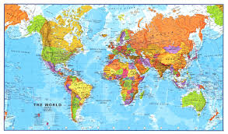
MAPS
Map Representation of a physical plane with selective information. Maps represent a definite area and contain detailed geographical information.

Slide 39
Types of maps
Political Map: A political map does not show any topographic features. It instead focuses solely on the state and national boundaries of a place. They also include the locations of cities - both large and small, depending on the detail of the map.

Slide 40
Physical Map: A physical map is one that shows the physical landscape features of a place. They generally show things like mountains, rivers and lakes and water is always shown with blue. Mountains and elevation changes are usually shown with different colors and shades to show relief. Normally on physical maps green shows lower elevations while browns show high elevations.

Slide 41
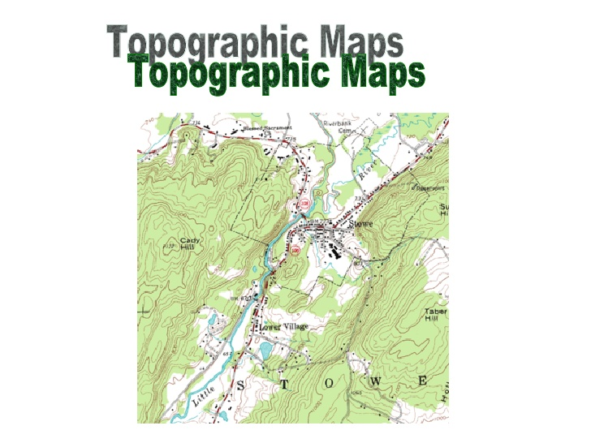
Topographic Map: A topographic map is similar to a physical map in that it shows different physical landscape features. They are different however because they use contour lines instead of colors to show changes in the landscape.

Slide 42
Climate Map: A climate map shows information about the climate of an area. They can show things like the specific climatic zones of an area based on the temperature, the amount of snow an area receives or average number of cloudy days.

Slide 43
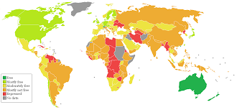
Economic or Resource Map: An economic or resource map shows the specific type of economic activity or natural resources present in an area through the use of different symbols or colors depending on what is being shown on the map.

Slide 44
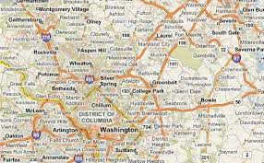
Road Map: A road map is one of the most widely used map types. These maps show major and minor highways and roads (depending on detail) as well as things like airports, city locations and points of interest like parks, campgrounds and monuments.

Slide 45
Thematic Map: A thematic map is a map that focuses on a particular theme or special topic and they are different from the six aforementioned general reference maps because they do not just show natural features like rivers, cities, political subdivisions, elevation and highways.

Slide 46
Uses of maps

Slide 47
Classification of maps
REFERENCE OR NAVIGATIONAL MAPS
are created to help you navigate over the earth surface. These kinds of maps show you where particular places are located and can be used to navigate you way to them. A street map or the common highway road map falls into this category. Physical geographers use topographic maps to show the locations of landscape features on the earth.

Slide 48
Classification of maps
TOPOGRAPHIC MAPS illustrate the horizontal and vertical positions (relief) of land surface features. Topographic maps use contour lines to show elevation (height above sea level).
THEMATIC MAPS are used to communicate geographic concepts like the distribution of densities, spatial relationships, magnitudes, movements etc. World climate or soils maps are notable examples of thematic maps.

Slide 49
Map essentials
TITLE
Shows what the subject of the map is.
COMPASS ROSE
It has arrows which point in all 4 principal directions.
SCALE
Used to represent distances between two points on a map.

Slide 50
BAR SCALE
A scale on a map which gives distances in miles or kilometers using bars.
LEGEND
Used to explain what the symbol on a map represents.
KEY
Another name for a legend on a map.
LOCATOR MAP
Shows where in the world the area on the map is located.

Slide 51
PRINCIPAL DIRECTIONS
The four directions found with a compass - North, South, East, and West.
CARDINAL DIRECTIONS
Another name for the principal directions.
POLITICAL MAPS
Maps which show the major political features of a region.
POLITICAL FEATURES
They include country borders, capital cities and other features.
CAPITAL CITIES
They are shown as a star on a map.
PHYSICAL MAPS
Maps which show the major physical feature of a region.

Slide 52
PHYSICAL FEATURES
They include mountains ranges, rivers, oceans, islands, deserts and plains.
SPECIAL PURPOSE MAPS
Maps which focus on one special topic like climate, resources or population.
LINE SCALE
A scale an a map which gives distances in miles or kilometers using lines.

Slide 53
map projection
Cylindrical: In standard presentation, these map regularly-spaced meridians to equally spaced vertical lines, and parallels to horizontal lines.
Pseudocylindrical: In standard presentation, these map the central meridian and parallels as straight lines. Other meridians are curves (or possibly straight from pole to equator), regularly spaced along parallels.

Slide 54
Pseudoazimuthal: In standard presentation, pseudoazimuthal projections map the equator and central meridian to perpendicular, intersecting straight lines. They map parallels to complex curves bowing away from the equator, and meridians to complex curves bowing in toward the central meridian. Listed here after pseudocylindrical as generally similar to them in shape and purpose.
Conic: In standard presentation, conic (or conical) projections map meridians as straight lines, and parallels as arcs of circles.

Slide 55
Pseudoconical: In standard presentation, pseudoconical projections represent the central meridian as a straight line, other meridians as complex curves, and parallels as circular arcs.
Azimuthal: In standard presentation, azimuthal projections map meridians as straight lines and parallels as complete, concentric circles. They are radially symmetrical. In any presentation (or aspect), they preserve directions from the center point. This means great circles through the central point are represented by straight lines on the map.

Slide 56
Other: Typically calculated from formula, and not based on a particular projection
Polyhedral maps: Polyhedral maps can be folded up into a polyhedral approximation to the sphere, using particular projection to map each face with low distortion.
Retroazimuthal: Direction to a fixed location B (by the shortest route) corresponds to the direction on the map from A to B.

Slide 57
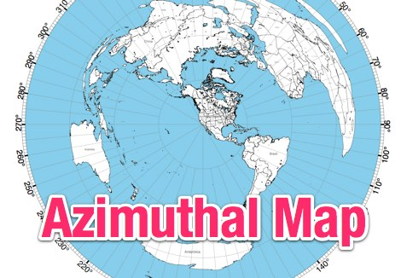
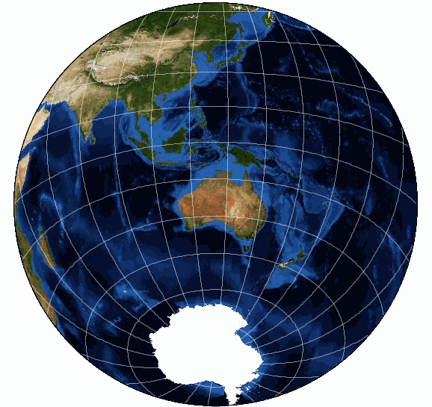
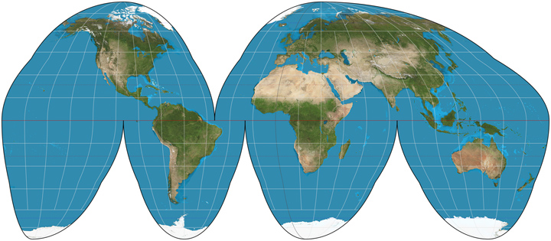

Slide 58
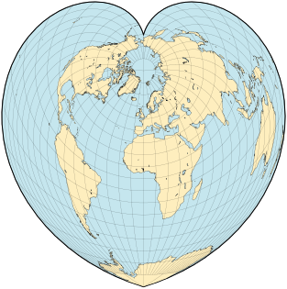
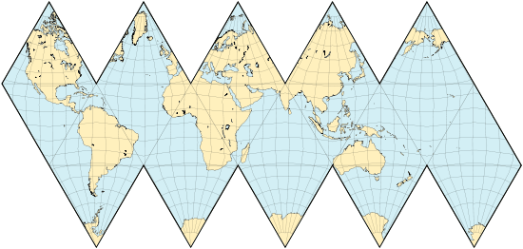
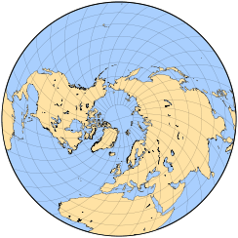

Slide 59
Flora and fauna
Fauna derives from the name of a Roman goddess, but the handiest way to remember flora and fauna is that "flora" sounds like flowers, which are part of the plant world, and fauna sounds like "fawn," and fawns are part of the animal kingdom.

Slide 60
Flora and fauna refer to plant and wildlife, respectively. The term is often used to refer to the indigenous plant and wildlife of a geographical region. Both are collective terms, referring to groups of plant or wildlife specific to a region or a time period. For example, the flora and fauna of a warm region may consist of tropical to warm-temperate vegetation and exotic species of birds.

Slide 61
By definition, flora is a word of Latin origin referring to Flora, the goddess of flowers. The term can refer to a group of plants or to bacteria. Flora is the root of the word floral, which means pertaining to flowers. Fauna can refer to the animal life or classification of animals of a certain region, time period, or environment. The term is also of Latin origin, and in Roman mythology, Fauna was the sister of Faunus, a good spirit of the forest and plains.

Slide 62
The flora and fauna of any given region are usually explained in biological terms to include the genus and species of plant and animal life, their preferred growing or breeding habits, and their connection to one another in the environment as well. In addition to geographical groupings, environment also helps further their classification. For example, aquatic flora and fauna of a region refers to the plant and animal life found in the waters in or surrounding a geographic region.

Slide 63
The importance of flora and fauna to human existence on earth
Flowers and animals; we can't live without them. The flora of the earth produce the oxygen that is breathed by the fauna and in turn, the fauna exhale the carbon dioxide that the flora need to live. One cannot live without the other, and humans cannot live without either; hence their importance.

Slide 64
Flora and fauna are the plant and animal life of a region in a period of time. That may sound simple, but the ecosystem created by the interdependence of these two life forms is not simple at all. In fact, humans cannot breathe unless both flora and fauna survive and thrive on the earth.

Slide 65
The very air we breathe and the food we eat, the medicines that cure us, and the water that keeps us alive would not exist were it not for flora and fauna. All things in an ecosystem are interdependent. The existence of one species may depend on the health of another, such as the relationship of bamboo forests to pandas. Pandas only eat bamboo shoots, so the destruction of the bamboo forests in China resulted in the endangerment of the Panda, due to starvation and loss of habitat.

Slide 66
In China, destruction of the forests left the tigers with no place to go. Farmers killed them in great numbers to protect their farm animals, and soon there were few left. In an attempt to save the species, Chinese tigers were moved to the forests of Africa, where they are surviving nicely.

Slide 67
Endangerment of Ocean Flora and Fauna
The importance of flora and fauna in the oceans cannot be underestimated, many of which are endangered or extinct due to pollution and other of man's actions.
Excessive dumping of nitrogen rich fertilizers into the Gulf of Mexico has created the growth of huge colonies of red algae, called "red tide", which kills millions of ocean creatures every year, and even a few hypersensitive humans.

Slide 68
The mass killing of sharks has created a dangerous overpopulation of sting rays. Overfishing and whaling in Japan has caused many species of whales to be seriously endangered.
The Great Barrier Reef, home to millions of the ocean's species, is dying due to pollution and rising water temperatures, which is causing a ripple effect unlike any we will ever again see.

Slide 69
Global Effects of the Destruction of Flora and Fauna
The importance of flora and fauna cannot be seen anywhere as distinctly as in our rainforests. The Amazon rainforest once gave us 20% of our oxygen supply. As their destruction has progressed, so has the incidence of respiratory illness around the world. Some of our most effective drugs come from rainforest plants. Destruction of these plants, and their habitats, will not only affect our health, but our very lives.

Slide 70
Half of the world's species of plants, animals and microorganisms have become endangered or extinct due to this pernicious destruction of the rainforest. Birds and animals are in part responsible for keeping the rainforest alive, by spreading seeds through their feces. Without them, many plant species cannot propagate, and will disappear.

Slide 71
Man's Destruction of Ecosystems
Man, in his quest for money and power, has created a world in which the ecological balance of flora and fauna has been destroyed, in many instances causing the extinction of entire species due to destruction of habitat and food sources.
Manmade "acid rain" killed entire forests when it blew into Canada and fell on the trees there. Smog has killed plants, animals and even humans. The hole in the ozone, said to be the main cause of the melting arctic ice caps, is (like acid rain) believed to be caused by the foul emissions of coal burning factories.

Slide 72
Global Actions Cause Local Conséquences
The world's ecology is so complex, so fragile, so interdependent, that an ecological upheaval of the flora and fauna of one region of the world (i.e. the destruction of rainforests) can affect the entire planet.
Global trade has introduced species to areas outside of their natural habitat, where there are no predatory species to control their destructive habits.
Fire ants were brought to the United States in a cargo ship. They have caused the death of livestock, people, and many native species of ants and insects.
You need look no further than Florida to see the importance of native flora and fauna on the local ecosystems.

Slide 73
Plants like Kudzu, Brazilian Pepper, Australian Pine, and Chinese Tallow were brought in from other countries to the United States and have invaded and destroyed entire habitats of native flora. The Everglades is being destroyed by Malaleuca, which was seeded by airplanes to dry up the Everglades and allow sugar cane to be planted after the Cuban embargo.
The introduction of non-native brown anoles and Cuban tree frogs into Florida has nearly caused the extinction of native lizard and toad species, which are their prey. Iguanas and other large lizard species, as well as large snakes such as boas and pythons, are invading the Everglades and other ecologically sensitive areas.

Slide 74
In fact, Florida and its port cities have introduced and become invaded by more invasive non-native species than any other state in the U.S.
Imports of salmon eggs into Japan have caused outbreaks of disease into several of their native fish species, causing great economic and ecological losses.
The list goes on indefinitely. The University of Arizona site tells a shocking tale of the ecological and economic cost of invasive flora and fauna to the U.S. alone every year.

Slide 75
What Can Be Done?
The situation simply is out of control, and although many organizations such as Greenpeace and the World Wildlife Fund, as well as local societies and agencies worldwide are trying, there may be no solution.
The indigenous flora and fauna of the world are dying, and the ecosystem as we know it is dying with them. It has been said, that if insects decided to take over the world, we would all be doomed. If things keep going the way they are, they may just have their chance.

Slide 76
Locally, you can find organizations that are working to teach the importance of flora and fauna native to your area and volunteer or donate money. Globally, you can join organizations like the World Wildlife Fund and support their worldwide mission to save the flora and fauna that support the world's ecological systems.

Slide 77
Thank You

