Slide 1
JHUMRI TELAIYA COMMERCE COLLEGE
Prof. Arbind Kumar Sinha
Assistant Professor
Jhumri Telaiya Commerce College

Slide 3
Political Science
The method of political science is the interpretation of life; its instrument is insight, a nice understanding of subtle, unformulated conditions.
- Woodrow Wilson

Slide 4
JHUMRI TELAIYA COMMERCE COLLEGE
Introduction to Political Science

Slide 5
Year of Establishment
Department of Political Science was established in 1984.
Ranchi University and Now (Vinoba Bhave University) has introduced
choice based credit system from 2015-16.

Slide 6
Faculty Members – Department of Political Science
Prof. Arbind Kumar Sinha
Head of Department (HOD), Political Science
Educational Qualification: M.A. Date of Joining: 19th May 1988 Experience: 37 years
Journal Published: “Role of Human Rights in Present Time” Workshops & Seminars Attended:
NAAC Sponsored National Workshop (2013) – Improving Quality of Teaching and Learning in Classroom
ICMRT 2023 – Innovative Challenges in Multidisciplinary Research & Techniques
ERO Sponsored National Seminar (2014) – Water Management in the Service of Mankind
Vidya Bharti Sanskriti Shiksha Sansthan, Kurukshetra – Workshop on Indian Moral Value
2. Prof. Rameshwar Rana
Department of Political Science

Slide 7
Subject’s Scope-
Political Theory – Studies concepts like liberty, justice, equality, and rights.
Comparative Politics – Compares governments, political systems, and institutions across countries.
International Relations – Analyses relations between nations, diplomacy, and global issues. Public Administration – Focuses on policy implementation, bureaucracy, and governance. Law & Constitution – Studies constitutional frameworks, legal systems, and citizens' rights.
Subject’s Vision-
Promoting Good Governance – Aims to build transparent, accountable, and effective political systems.
Ensuring Justice and Equality – Strives to create a fair society based on equal rights and opportunities.
Strengthening Democracy – Encourages citizen participation, rule of law, and protection of freedoms.
Fostering Global Peace and Cooperation – Works toward resolving conflicts and promoting international harmony.
Educating Responsible Citizens – Inspires informed, active, and ethical participation in public life.

Slide 8
How students can fulfil the aim and vision of political science?
Stay Informed and Aware – Regularly follow news, political events, and global affairs to understand real-world applications.
Engage in Debates and Discussions – Participate in forums, debates, or model parliaments to develop critical thinking and public speaking.
Study Political Theories and Systems – Gain deep knowledge of political ideologies, governance models, and legal structures.
Promote Civic Responsibility – Practice voting, volunteering, and raising awareness about democratic values and rights.
Pursue Internships and Fieldwork – Get practical exposure by working with NGOs, government bodies, or political organizations.

Slide 9
Faculty
SL. No. | Name of the Faculty | Designation | Qualification | Experience
1 | Prof. Arbind Kumar Sinha | Asstt. Professor | MA, | 30
2 | Rameshwar Pd. Rana | Asstt. Professor | MA | 30

Slide 10
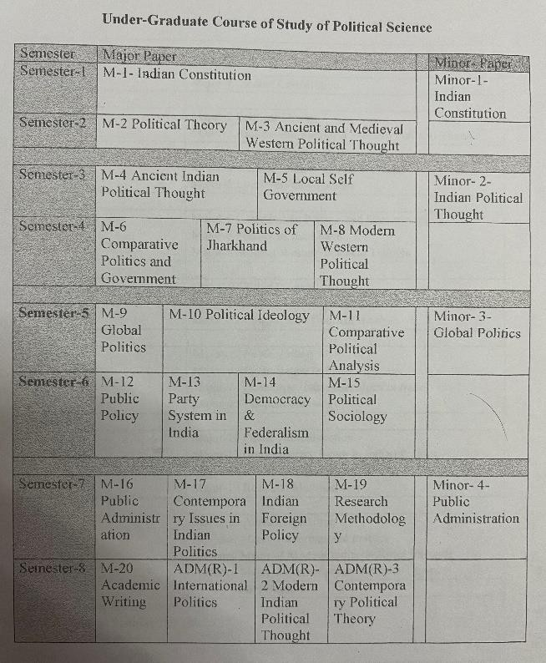
Class Routine

Slide 11
Students Strength
Sl. No | Year | SC | ST | OBC | GEN | Total
01 | 2018-19 | 09 | 0 | 135 | 11 | 155
02 | 2019-20 | 26 | 0 | 192 | 13 | 231
03 | 2020-21 | 27 | 0 | 212 | 25 | 264
04 | 2021-22 | 21 | 0 | 166 | 21 | 208
05 | 2022-23 | 26 | 0 | 200 | 28 | 254
06 | 2024-25 Current

Slide 12
Students Result
Sl. No | Year | Appear | Passed | Remark’s
01 | 2018-19 | 22 | 15
02 | 2019-20 | 15 | 13
03 | 2020-21 | 87 | 79
04 | 2021-22 | 103 | 84
05 | 2022-23 | 173 | 144

Slide 13
Students Achievements
Highest Marks Obtained Students (Last Five Years)
1 | Akash Kumar | 86.66%
2 | Md Majhar Imam Ansari | 90.80%
3 | Suraj Kumar Yadav | 81.55%
4 | Ritika Kumari | 83.24%
5
6
7

Slide 14
DISCUSSION POINTS
Introduction
What is Political Science?
Subject matters of Political Science ;
Is Political Science a Science?

Slide 15
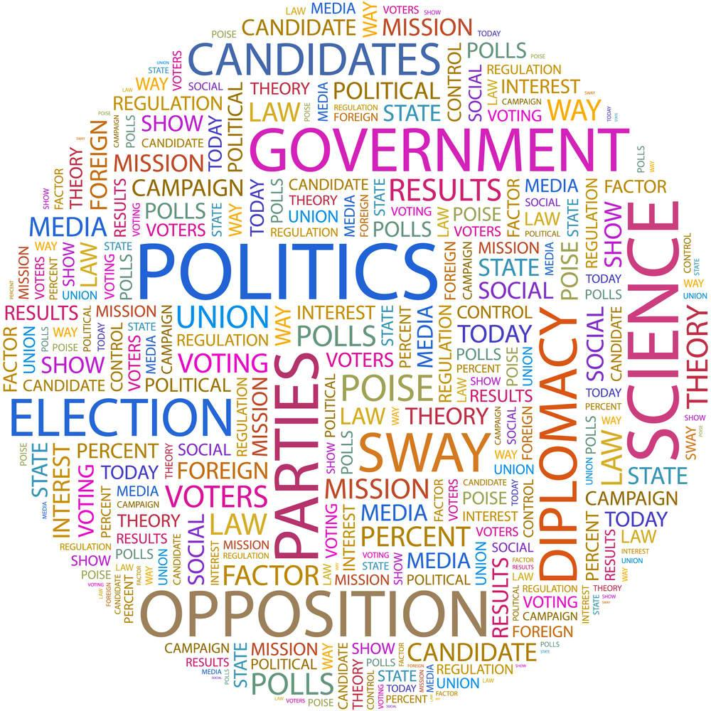
INTRODUCTION
Political science is a social science discipline that deals with systems of government and the analysis of political activity and political behavior. It deals extensively with the theory and practice of politics which is commonly thought of as the determining of the distribution of power and resources.

Slide 16
WHAT IS POLITICAL SCIENCE?
Political science is a social science discipline .
According to Greek Philosopher Aristotle, “Political Science is the master of all sciences.”
To know about Political Science first it is important to know about Politics, as both Political Science and Politics are often used interchangeably.
It is believed that the term politics is derived from the word Polis the exact meaning of which is city-state.
In ancient Greece, polis or the city state was the most popular and general form of political organization.
In today’s world by politics we generally mean the activities associated with the governance of a country or area.

Slide 17
WHAT IS POLITICAL SCIENCE?
So Political science basically is, the study of state, government and politics.
But it is also proved that Political science is not only the study of government and state but also it is the application of empirical theory and scientific methods to the analysis of political matters.
And it also deals with political ideas, ideologies, institutions, policies, processes and behaviour, as well as groups, classes, government, diplomacy, law, strategy, and so on.

Slide 18
SUBJECT MATTER OF POLITICAL SCIENCE
Association in Paris in 1948 to delineate its scope. It classified the same into four zones, namely, Political Theory, Political Institution, Political Dynamics and International Relations. We may attempt to describe its scope as follows.
1. Political Theory: A clear understanding of these basic terms and concepts is essential for the study of Political Science. A student of Political Science must start his lessons with political theory.
2. Political Philosophy: It is concerned with the theoretical and speculative consideration of the fundamental principles used by Political Science. Eminent political philosophers like Plato, Aristotle, Machiavelli, Hobbes, Locke, Rousseau, Hegel, Mill, Marx, and Gandhi have expressed their views on nature, functions and ends of the state and government.
3. Political Institutions: The scope of Political Science extends to the study of the organisation and working of formal institutions like the legislature, the executive and the judiciary, and in these days, of the electorate and even the administration.

Slide 19
SUBJECT MATTER OF POLITICAL SCIENCE
4. Political Dynamics: The term refers to the forces and processes at work in government and politics. They influence and explain political action. They include the study of political parties, pressure groups, interest groups, lobbies, public opinion, propaganda and political semantics (meaning of words) which influence and manipulate political behaviour and attitudes of individuals and groups.
5. Public Administration: Public Administration is a major branch of Political Science and is emerging as an independent discipline in recent times. It deals with the organization, control and coordination of administrative machinery, personnel administration, financial administration, public relations, management, administrative law and adjudication etc. It also covers the study of local self-governing institutions like corporations, municipalities and Panchayati Raj institutions.

Slide 20
SUBJECT MATTER OF POLITICAL SCIENCE
6. International Relations and International Law: The study of international relations is a growing area of Political Science. It covers such important subjects as diplomacy, international politics, foreign policies and international organizations. In view of world peace, cooperation and even 'world government,' the need for strong international laws and sound international relations can hardly be exaggerated.
7. Relation between the State and the Individual: The proper adjustment between the authority and power of the state and liberty of the individuals is a knotty problem. Political Science deals with the proper sphere of state action, the limits of political control and the area of individual freedom.

Slide 21
IS POLITICAL SCIENCE A SCIENCE?
The controversy whether political science is science or not is as old as the subject itself. Even today the controversy has not died down. There are a large number of people, many of whom are prominent in their own fields, who believe that to call political science a science is simply a travesty of the word science.
But the opponents of this view forcefully argue that physics and chemistry are science no doubt but they are not only sciences, there are others types of science. Physics and chemistry are physical science but there are also social sciences and political science is a prominent branch of social science. When we call political science a branch of social science, we invariably use the word science in a broad sense.

Slide 22
IS POLITICAL SCIENCE A SCIENCE?
We can mention that though political science is not pure science like physics and chemistry it is undoubtedly a prominent branch of social science. This observation is laconic in nature and therefore requires elaboration. We have already noted Morgenthau’s definition of political science.
From the above observation we again conclude that what we declare as the content of political science is, in fact, derived from many other subjects which are known as branches of social science. Hence there is hardly anything like pure political science, various aspects and matters of political science are derived from a number of social sciences. Even political science borrows its method of analysis from other subjects.

Slide 23
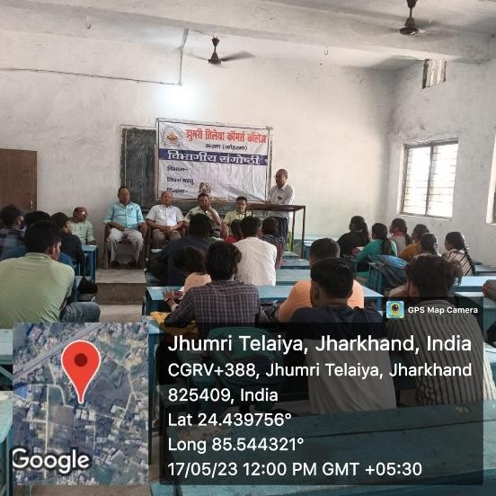
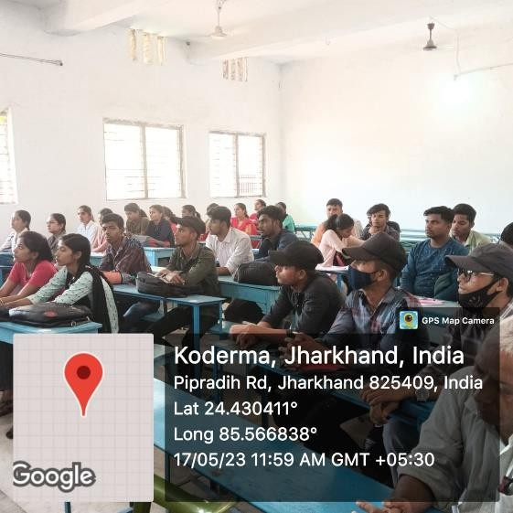
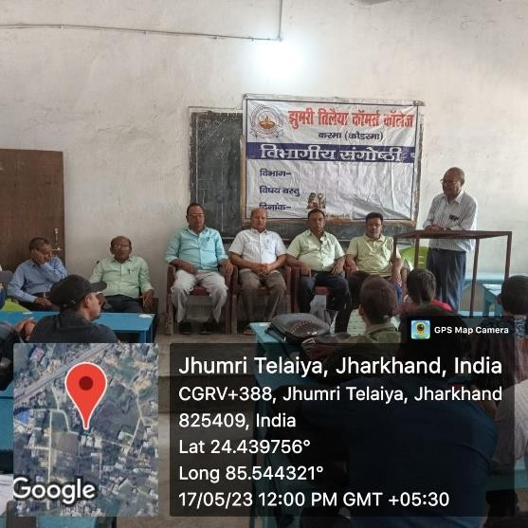
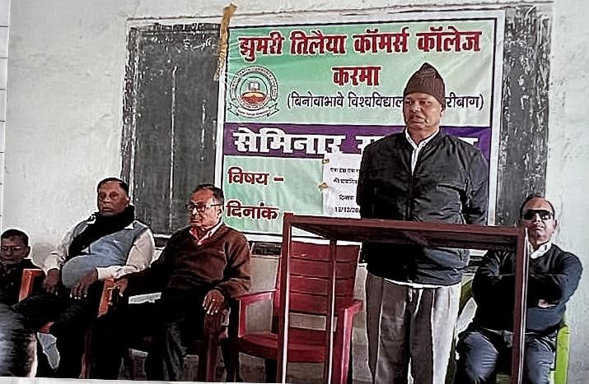
Department Activities/Seminar-
New Education Policy
One Nation One Election

Slide 24
Thank You

